Slide 1
NUMERICAL METHODS
1. SECANT METHOD
Solve x³ − x − 2 = 0; x₀=1, x₁=2; tolerance=10⁻⁶
Formula:
xᵢ₊₁ = xᵢ − f(xᵢ)(xᵢ−xᵢ₋₁) / [f(xᵢ)−f(xᵢ₋₁)]
First step:
f(1)=−2, f(2)=4
x₂ = 2 − 4(1)/(4−(−2)) = 1.333333
Final root ≈ 1.5213797

Slide 2
SECANT ITERATIONS
i x(i-1) x(i) x(i+1) f(x(i+1))
1 1.0000000 2.0000000 1.3333333 -9.630e-01
2 2.0000000 1.3333333 1.4626866 -3.333e-01
3 1.3333333 1.4626866 1.5311694 5.863e-02
4 1.4626866 1.5311694 1.5209264 -2.693e-03
5 1.5311694 1.5209264 1.5213763 -2.015e-05
6 1.5209264 1.5213763 1.5213797 7.015e-09

Slide 3
SECANT: FOR AND WHILE
FOR loop:
for i = 1:maxit
x2 = x1 - f(x1)*(x1-x0)/(f(x1)-f(x0));
if abs(f(x2)) < tol, break, end
x0=x1; x1=x2;
end
WHILE loop:
while i < maxit && err > tol
i=i+1;
x2=x1-f(x1)*(x1-x0)/(f(x1)-f(x0));
err=abs(f(x2)); x0=x1; x1=x2;
end

Slide 4
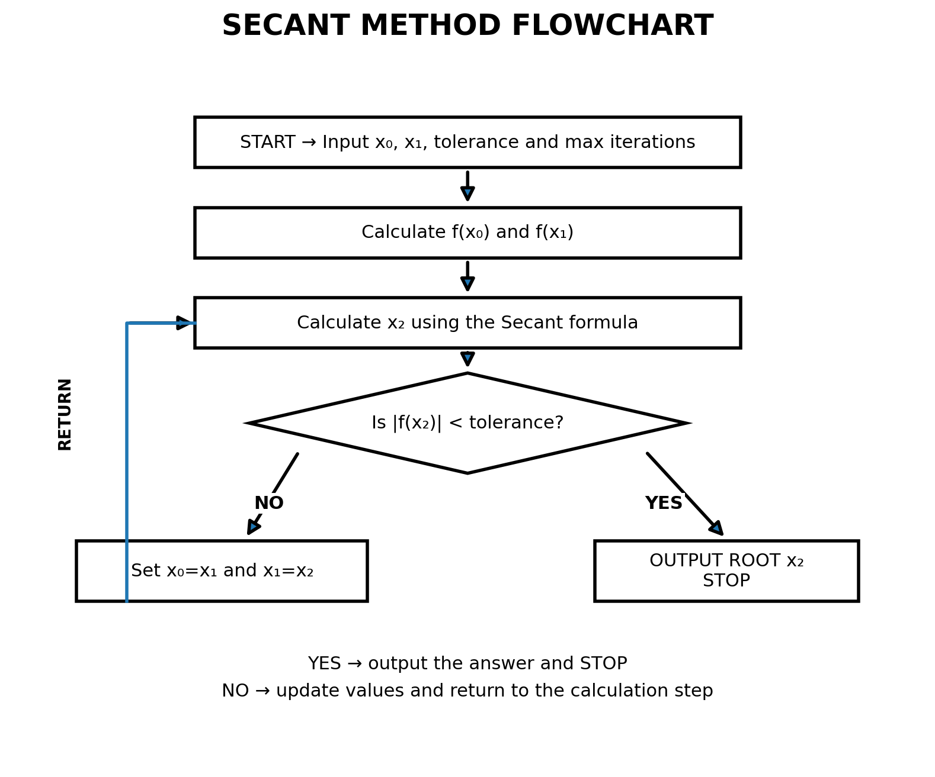
SECANT FLOWCHART

Slide 5
2. NEWTON-RAPHSON METHOD
Solve x² − 5 = 0; x₀=2; tolerance=10⁻⁶
f(x)=x²−5, f′(x)=2x
Formula: xᵢ₊₁ = xᵢ − f(xᵢ)/f′(xᵢ)
First step:
x₁ = 2 − (4−5)/4 = 2.25
Converged root ≈ 2.2360680

Slide 6
NEWTON-RAPHSON ITERATIONS
i x(i) x(i+1) f(x(i+1))
1 2.00000000 2.25000000 6.250e-02
2 2.25000000 2.23611111 1.929e-04
3 2.23611111 2.23606798 1.860e-09

Slide 7
NEWTON-RAPHSON: FOR AND WHILE
FOR loop:
for i = 1:maxit
x1 = x0 - f(x0)/df(x0);
if abs(f(x1)) < tol, break, end
x0=x1;
end
WHILE loop:
while i < maxit && err > tol
i=i+1;
x1=x0-f(x0)/df(x0);
err=abs(f(x1)); x0=x1;
end

Slide 8
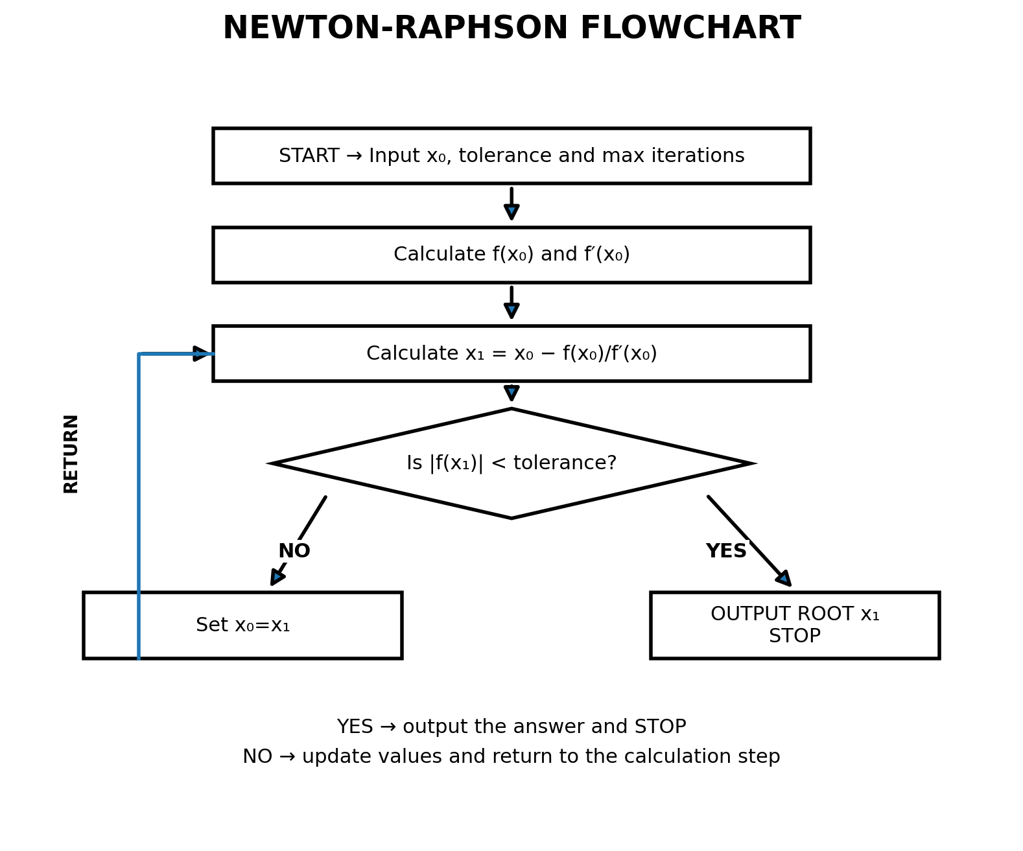
NEWTON-RAPHSON FLOWCHART

Slide 9
3. FOURTH-ORDER RUNGE-KUTTA (RK4)
Solve y′=x+y, y(0)=1, h=0.1, find y(0.3)
k₁ = h f(x,y)
k₂ = h f(x+h/2, y+k₁/2)
k₃ = h f(x+h/2, y+k₂/2)
k₄ = h f(x+h, y+k₃)
yₙ₊₁ = yₙ + (k₁+2k₂+2k₃+k₄)/6
Result: y(0.3) ≈ 1.3997176

Slide 10
RK4 ITERATIONS
Step x y k1 k2 k3 k4 y(next)
1 0.0 1.00000000 0.100000 0.110000 0.110500 0.121050 1.11034167
2 0.1 1.11034167 0.121034 0.132086 0.132638 0.144298 1.24280514
3 0.2 1.24280514 0.144281 0.156495 0.157105 0.169991 1.39971699

Slide 11
RK4: FOR AND WHILE
FOR loop:
for i=1:n
k1=h*f(x,y); k2=h*f(x+h/2,y+k1/2);
k3=h*f(x+h/2,y+k2/2); k4=h*f(x+h,y+k3);
y=y+(k1+2*k2+2*k3+k4)/6; x=x+h;
end
WHILE loop:
while x < xend
k1=h*f(x,y); k2=h*f(x+h/2,y+k1/2);
k3=h*f(x+h/2,y+k2/2); k4=h*f(x+h,y+k3);
y=y+(k1+2*k2+2*k3+k4)/6; x=x+h;
end

Slide 12
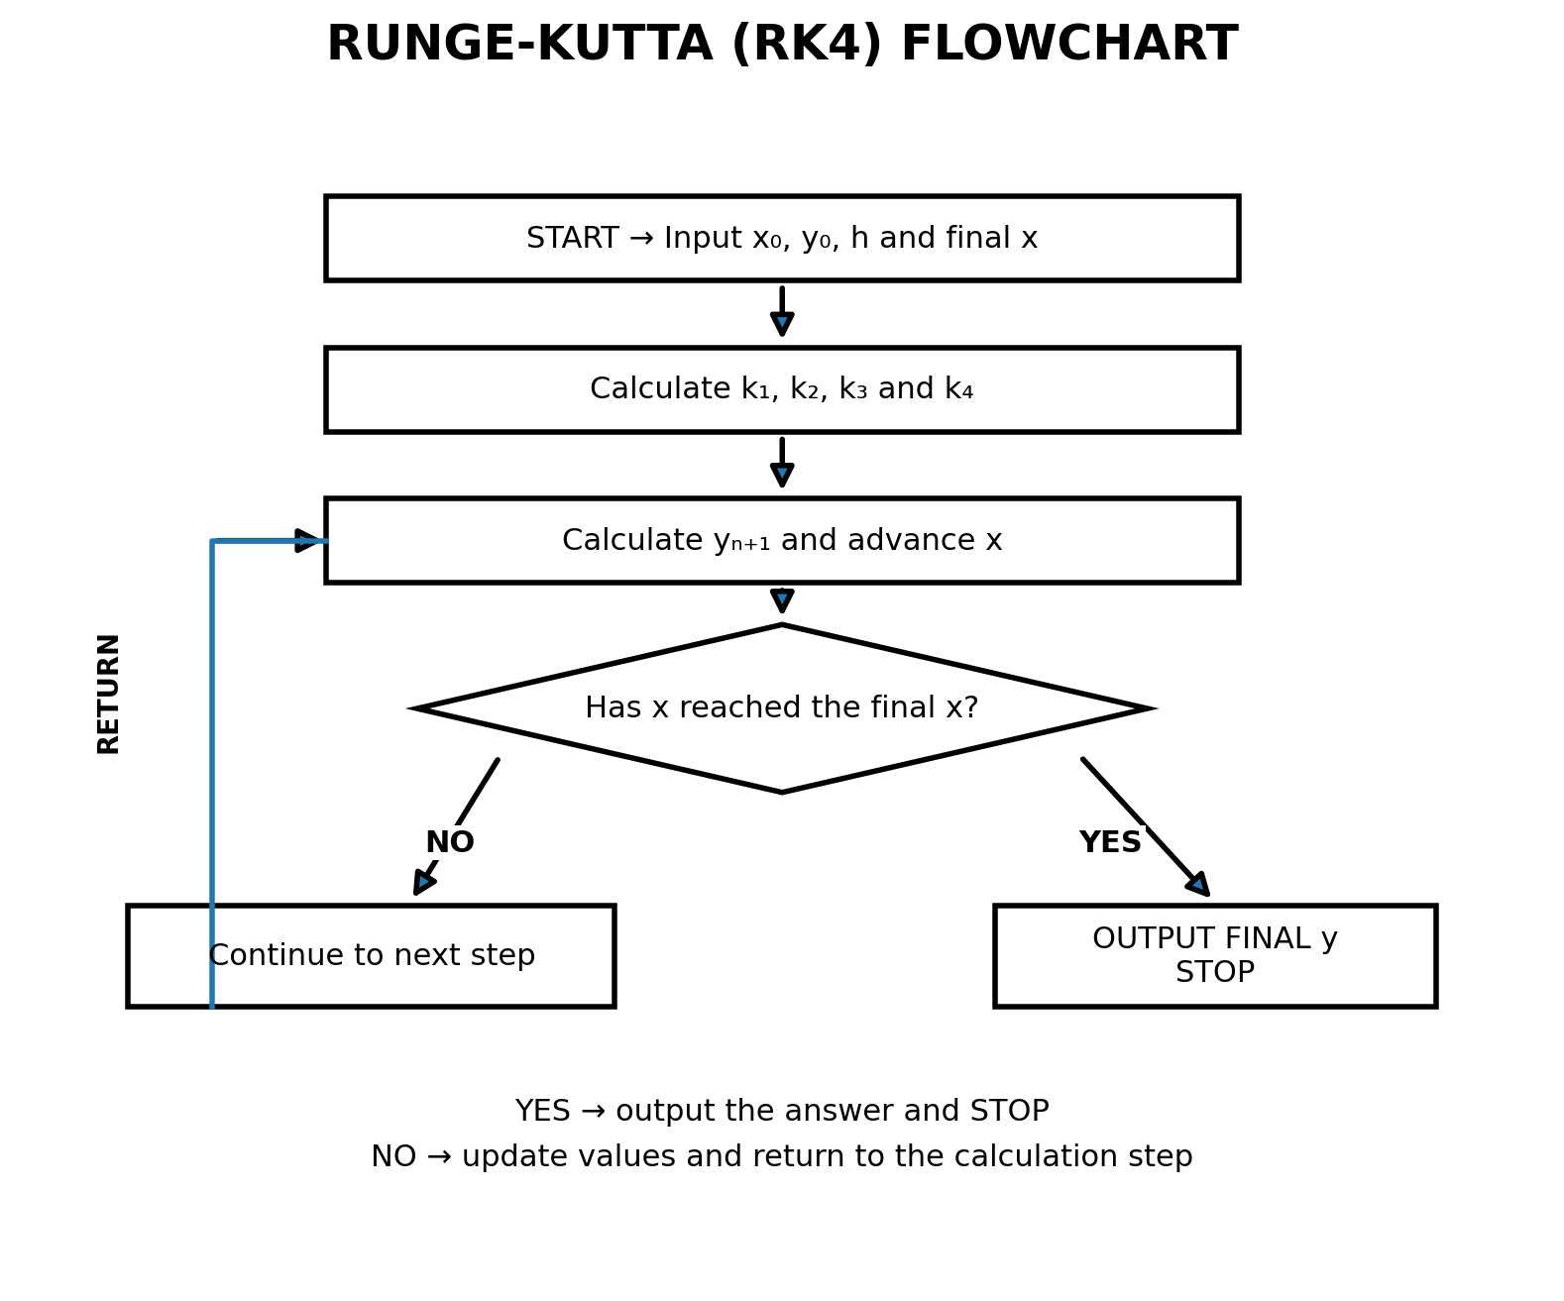
RK4 FLOWCHART

